Slide 1
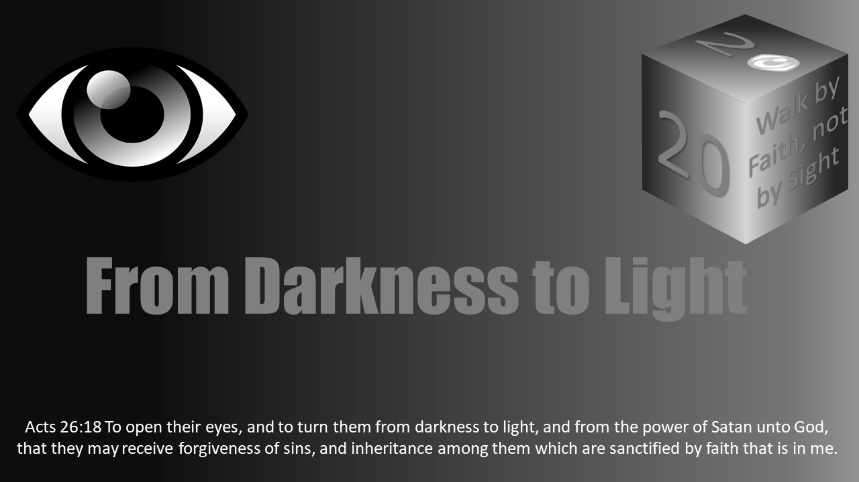


Slide 2

Darkness Lesson 22 Lust of the Eyes

Slide 3
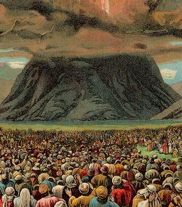
The Law on Sexuality and Sanctification
When God separated Israel from the rest of the world and established His covenant with them, He started with ten commandments. He spoke them from the mountaintop amid thunder, lightning, and smoke. The Israelites cried out that God would never speak to them like that again.
Two of those commands connected specifically with sexuality and sanctification.
The seventh command: “You shall not commit adultery.”
And the tenth command: “You shall not covet your neighbor’s wife.”

Slide 4
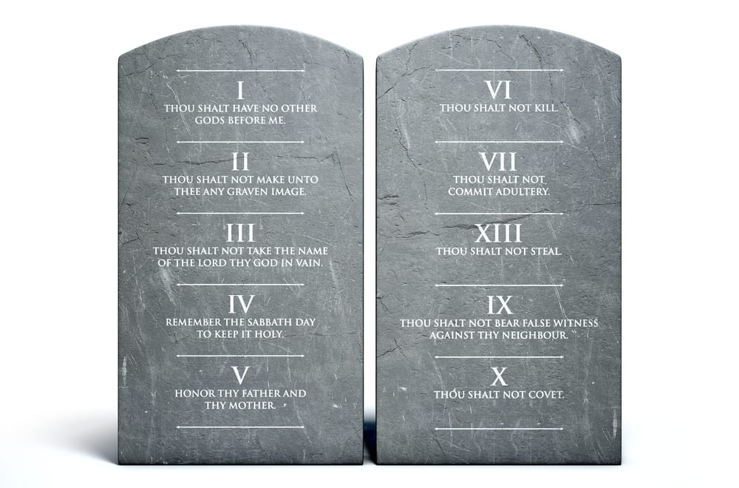
The Law on Sexuality and Sanctification
Have you ever asked why God chose those ten? Are these the ten most important of the 600+ laws in the Old Testament? Were these the laws that really distinguished Israel from the world? Why wasn’t circumcision on this list? Why weren’t the dietary laws on this list?
Preceding this covenant, God had demonstrated His power over the gods of the Egyptians with ten powerful and mighty plagues, bringing Israel out of bondage so they could be in covenant relationship with Him.
Now, in ten powerful and profound directives, He summarizes and explains what it means to be in a covenant relationship with Him.

Slide 5
The Law on Sexuality and Sanctification
Commandment #1: The covenant relationship with God is exclusive. God will not share His place in our lives with anyone or anything else. This cuts to the heart of what makes every sin actually sin. All sin is wanting something more than we want God.
Commandment #2: God defines the relationship. We are not entitled to design and define God from the art of our imagination. (See Acts 17:29.)

Slide 6
The Law on Sexuality and Sanctification
Commandment #3: While this command includes a prohibition of using God’s name as an exclamation, Leviticus 19:12 demonstrates the main concern was vainly using the name of God in an oath in the context of stealing from and lying to your neighbor. That is, the oath taker was trying to seize something from his neighbor he could not obtain through honest means. The heart of this command: God is the ultimate goal and not the tool we use to get what we really want.
Commandment #4: The Sabbath, whether the day or the year, explains man needs God. God does not need man. Man must rely on Him. But, praise the Lord, He is looking out for our benefit and blessing.

Slide 7
The Law on Sexuality and Sanctification
Commandment #5: This relationship with God was not for one generation only. A generational legacy of faithfulness to God is established by honoring those He has placed in our lives to teach us about Him.
Commandments #6, 7, 8, 9: Don’t take your neighbor’s life, wife, property, or reputation. While this seems to move in a new direction, talking not about our relationship with God, but mostly about our relationship with one another, that is not the case. The rest of the commandments have pushed us to realize God, as He is in reality, as He defines the relationship, is enough. Having Him and having what He has given us is enough. As David wrote, “The LORD is my shepherd; I shall not want” (Psalm 23:1). The person who murders, commits adultery, steals, or bears false witness against his neighbor, however, is saying God is not enough. What God has given is not enough. “The LORD is my shepherd; but I want more. Therefore, I will take it from others by sinful force.”

Slide 8

The Law on Sexuality and Sanctification
Commandment #10: This commandment leads us right back to commandment #1. We are not in good relationship with God by merely avoiding some external activities. Rather, we are to overcome the desire that leads to these activities. God is the Lord. He is more than enough. Sin is wanting anything more than or in place of God.

Slide 9
The Law on Sexuality and Sanctification
As Proverbs 18:22 declares, “He who finds a wife finds a good thing and obtains favor from the LORD.”
The one who is faithful to his wife is declaring God’s gifts are good. God’s gifts are enough.
The sexually immoral are declaring God’s gift is not enough, God’s timing is not enough, and therefore God is not enough.
The sexually immoral are declaring they want something more than they want God. They are declaring they do not trust God, His timing, His blessings.
They are actually abandoning their faith in God as the greatest good and the greatest blessing.
Sexual immorality is not wrong because God is trying to limit our fun. It is not wrong because God arbitrarily decided to establish a rule to see how we would measure up. It is not wrong because God wanted an excuse to condemn us.
It is wrong because sexual immorality says God is not enough.

Slide 10

The Meaning of Marriage
Regrettably, I have for too long read Genesis 2:18 through the lens of the Romanticism that has dominated the last 300 years.
I have too often read this verse based on Wordsworth and Tennyson, Shelly and Austen instead of Jesus and Paul, or even Moses and his actual context.
Moses did not cite God as declaring “It is not good that the man should be lonely, I’ll give him a companion.”
But rather, “It is not good that the man should be alone; I will make him a helper fit for him.” The aloneness is in the context of the mission God had given Adam.
“The LORD God took the man and put him in the garden of Eden to work it and keep it” (Gen 2:15).
Notice how it was worded in the previous creation account: “Be fruitful and multiply and fill the earth and subdue it, and have dominion…” (Gen 1:28).

Slide 11

The Meaning of Marriage
Have you ever noticed Eden is not actually the garden?
Rather, God planted a garden in Eden, in the east of Eden to be precise (Gen 2:8).
Man’s mission was to work and keep the garden, to be fruitful and fill the earth, to subdue the earth.
That is, Adam, having been created in the image of God (Gen 2:27), was to work and keep the garden in such a way that the garden of God filled the earth, and it was in turn to be filled with image bearers of God as Adam fruitfully multiplied.

Slide 12

The Meaning of Marriage
The garden was the very first sanctuary of God.
It was the first meeting place between God and man.
Though not made of stone and mortar, it was the first temple of God.
It was built around and guarded the way to the tree of life.
Man’s job was to spread that sanctuary throughout the entire world.
He needed God’s help through woman to accomplish it.

Slide 13

The Meaning of Marriage
Of course, man and woman violated their mission.
Rather than guarding the way to the tree of life and filling the earth with the garden, the tree and the garden were taken from the earth and the ground was cursed.
However, through Jesus Christ, God had a plan to redeem man and woman and to rebuild His sanctuary.
God has not replanted a garden. However, He has replanted His kingdom, His church, His temple, and His sanctuary.
We, God’s church, are the stones that make up that temple; we are that sanctuary (Eph 2:19-22; 1 Peter 2:4-5).

Slide 14

The Meaning of Marriage
This brings us to Ephesians 5:22-33.
Wives are to submit to and respect their husbands as the church does Christ.
However, more fundamentally and more shocking in Paul’s day, husbands are to love their wives as Christ does the church, sacrificing self for her.
This passage translates and transports for us God’s meaning and purpose for marriage from the garden to the gospel.

Slide 15
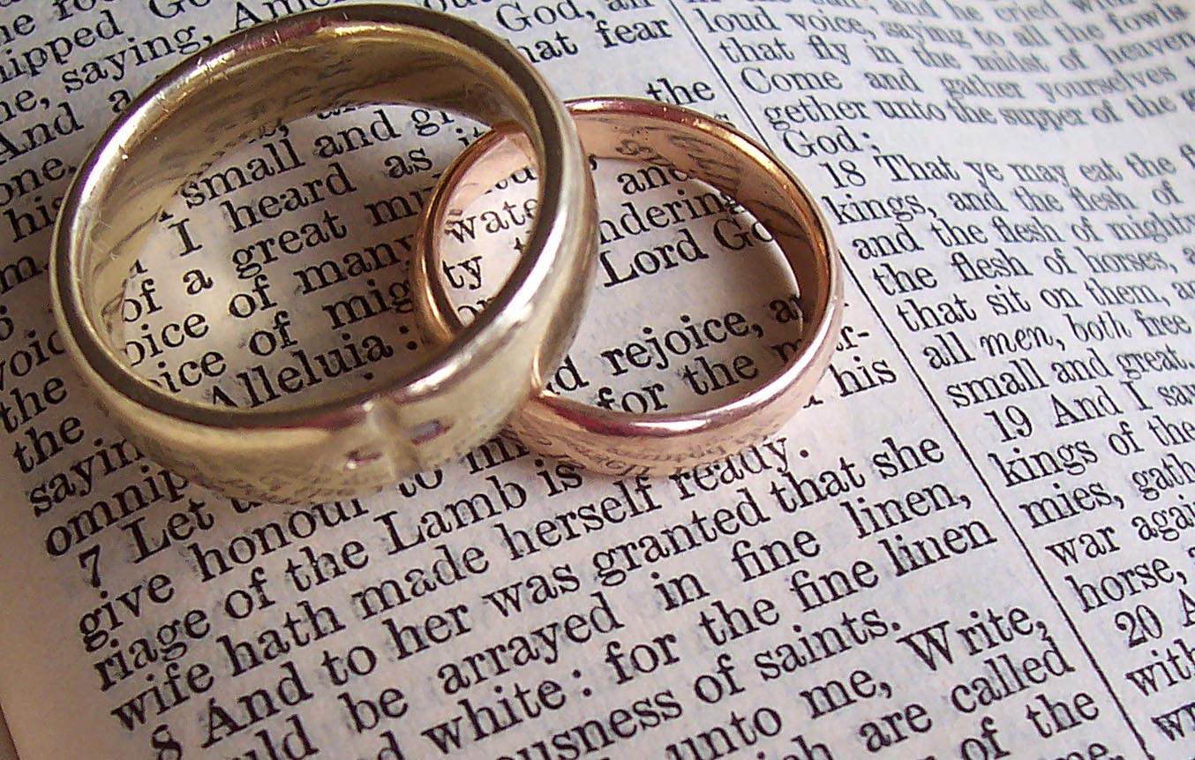
The Meaning of Marriage
The original purpose of marriage was to spread the garden sanctuary of God throughout the world, filling it with God’s image-bearers.
The transcending meaning of marriage is to spread the gospel sanctuary of God throughout the world, filling it with God’s image-bearers.
The fundamental way marriage does this is by visibly representing Christ and the church to the world.
Marriage is intended to be a picture of the gospel, drawing folks into the sanctuary of God.
Paul is not saying we know how marriage is supposed to work because we know the gospel. He is saying people should see how the gospel works by seeing how marriage works.
Marriage is intended to pave the way to the tree of life. That is, it is to pave the way to the cross of Jesus Christ—the tree which on the surface seems to be a tree of death, but it is actually the source of all life in God’s kingdom

Slide 16

The Meaning of Marriage
Understand, this is why God has laws surrounding marriage and sexuality.
Marriage is to bear the image of Jesus and His bride, the church.
The meaning of marriage is the gospel itself and all forms of sexual immorality distort and pervert the picture of the gospel.
This is why living together outside of marriage is a sin, premarital sex is wrong, and multiple sexual partners(even serial monogamy) is unlawful—not because God is trying to limit our fun or sexually stunt us, but because these sins distort the picture of Christ’s covenant relationship with His church.
These pictures set an expectation of having the blessings of the covenant without surrendering to the covenant. Further, they deny the exclusivity of Christ’s covenant with His church as if He showers His salvation and covenant on any and everyone instead of just upon His church.

Slide 17

The Meaning of Marriage
This is why divorce, in general, is sinful – not because God wants us to be miserable in unhappy marriages, but because it distorts the picture of Christ’s commitment to His church and the church’s surrender to its Savior and King.
Divorce paints a picture that Christ loves His church so little that her shortcomings, struggles, weaknesses, and sins would cause Him to abandon her.
And, it depicts Christ’s love for the church is so weak that the church does not appreciate it, long to surrender to it, and remain under His covering.

Slide 18
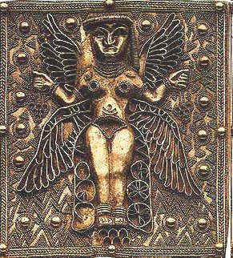
The Meaning of Marriage
This is why the only lawful divorce is for the cause of sexual immorality—not because a cheating spouse causes so much more pain than any other sin in marriage, but because sexual immorality has long represented worshiping idols and was the only reason God ever put His people away. (Photo: Ashteroth idol).

Slide 19
The Meaning of Marriage
This is why same-gender sexual relations and marriages are wrong – not because God is trying to keep people from loving relationships, but because they distort the picture of Christ’s relationship with His bride the church.
Christ did not sacrifice Himself for one like Himself.
Nor did Christ pursue personal satisfaction in a relationship because it was merely what attracted Him.
Further, the church cannot be saved by one who is merely like her, but can only be saved by Jesus, the Christ: one who is different from her.

Slide 20
The Meaning of Marriage
Hebrews 13:4 says, “Let marriage be held in honor among all, and let the marriage bed be undefiled, for God will judge the sexually immoral and adulterous.”
God is not trying to limit our fun.
He is not establishing arbitrary rules to see if we’ll measure up or because He is trying to establish such high standards that we are certain to fall.
God established the commands because marriage and the beauty of sexuality within marriage represent Christ and His church.
Sexual immorality distorts it, perverts it, and destroys it.

Slide 21

The Meaning of Marriage
If you think making this parallel of marriage and sexuality within it to the church’s relationship with Jesus is tawdry or base, consider God’s use of this very imagery in Psalm 45.
It is a psalm of love between God’s King and the King’s bride.
It is not a song memorializing a wedding between David or Solomon and any of their wives. It is a song foretelling of Christ and His bride.
Every marriage is supposed to tell that story.
Thus, sexuality is beautiful and holy in marriage, and it is destructive and sinful anywhere else.

Slide 22
Sexuality and Sanctification
With this understanding of marriage in mind, we come to 1 Thessalonians 4:1-8.
Further, we can now understand it in the context of the biblical picture of sexuality and sanctification.
Finally, then, brothers, we ask and urge you in the Lord Jesus, that as you received from us how you ought to walk and to please God, just as you are doing, that you do so more and more. 2 For you know what instructions we gave you through the Lord Jesus. 3 For this is the will of God, your sanctification: that you abstain from sexual immorality; 4 that each one of you know how to control his own body in holiness and honor, 5 not in the passion of lust like the Gentiles who do not know God; 6 that no one transgress and wrong his brother in this matter, because the Lord is an avenger in all these things, as we told you beforehand and solemnly warned you. 7 For God has not called us for impurity, but in holiness. 8 Therefore whoever disregards this, disregards not man but God, who gives his Holy Spirit to you.

Slide 23
Sexuality and Sanctification
Sexual immorality was a common practice among the pagans and even part of their worship.
This may be part of the reason sexual immorality and prostitution were common metaphors for idolatry in the Old Testament (e.g. Ezek 23) and a metaphor for friendship with the world in James 4:4.
Paul, however, wants to make it clear they are not at all part of the Christian worship or life.
No disciple had the right to his brother’s wife (or, for that matter, a right to her sister’s husband). There are no cult prostitutes in Christianity. There is no spouse swapping among the brethren.

Slide 24
Sexuality and Sanctification
Relationships within Christ’s church run deep.
Spiritual intimacy is strong among a close-knit group of people set upon by the world.
Those who mutually support each other in such unique living as gospel living draw close to each other.
Spiritual intimacy is just a hop, skip, and a jump away from romantic intimacy. Disciples are to guard against those connections.
Paul explains such relationships are sinful. God will avenge such a wrong done to one another.

Slide 25
Sexuality and Sanctification
While Paul’s ultimate application in this passage is about potential sexual immorality between brethren, he bases his point on a more fundamental and broadly sweeping principle.
Unlike in paganism, God has not called us to self-expression, sensuality, and immorality.
God’s will for us is sanctification and holiness.
God’s will for us is to be separate from the world and from worldly activities and relationships.
God’s will for us is to become like Him.
And He, above all, is faithful. He, above all, is love. He, above all, is holy. Christians are not to pursue sexual immorality with anyone, let alone with their brothers and sisters in Christ.

Slide 26

Sexuality and Sanctification
The forgiveness that is given in Christ is not a cloak for the passions of the flesh.
We do not enter as Christ’s bride and then act as if immorality will be winked at. We cannot say, “Well, just this once won’t hurt.”
As Galatians 5:13 says, we are called to freedom, but we are not free to pursue the works of the flesh. Rather, we are to lovingly serve one another.
Sexual immorality is the exact opposite. Seeking the benefits and blessings of the marriage covenant without engaging in the commitment of that covenant can never be seen as real love. It is selfishness.
Violating the commitment of your covenant to your spouse can never be seen as love toward your spouse or the person you are violating the covenant with. It is self-seeking.

Slide 27

Sexuality and Sanctification
Sexual immorality is stealing for ourselves what does not belong to us.
By that very definition, it is not love. It is not the fruit of the Spirit, but a passion and work of the flesh.
Thus, Paul explains in 1 Thessalonians 4:1-8, not only is the actual acting out of sexual immorality sinful, but living in the passion of lust is living like the world, not like Christ.
When Christians have eyes and hearts full of adultery (2 Pet 2:14; Matt 5:28), they are not becoming like Jesus, they are going back to their worldly sinfulness.
The clichéd justification, “Just because I’m on a diet doesn’t mean I can’t look at the menu,” is bogus.
We are to look to Jesus and Jesus alone.
The idea that we want to get away with as much as we can, but still go to heaven is a sham. Heaven is the presence of Jesus, and when we allow or pursue sexual immorality, we are running from Jesus.

Slide 28

Sexuality and Sanctification
In Galatians 4:19, Paul explained he was in the anguish of childbirth until Christ was formed in the Galatians.
From his letter to the Thessalonians we learn, sexual immorality, sensuality, lustful passion is the exact opposite of Christ being formed in us. It is Christ being kicked out of us.
As 1 Peter 1:14-16 says, we must not revert to the passions of our former ignorance.
Our God is not a philandering, sexually immoral deity like so many of the Roman and Greek gods. Rather, we have been called by a holy God.
Therefore, we are to be holy as He is.

Slide 29
Sexuality and Sanctification
At the end of Paul’s instruction in 1 Thessalonians 4:8, he drives his point home. “Therefore whoever disregards this, disregards not man but God, who gives his Holy Spirit to you” (1 Thessalonians 4:8).
In other words, Paul says, “If you disagree with this, you aren’t disagreeing with me. You are disagreeing with God. If you argue with this, you are not arguing with me. You are arguing with God. If you rebel against this, you are not rebelling against me. You are rebelling against God.”
And many today want to disregard this. However, Christians must not.

Slide 30

Do Not Be Deceived
The world tells us we are Victorian and prudish for abstaining from sexual immorality. They claim we are sexually stunted.
They maintain we are denying our evolutionary journey and then conclude we are missing out.
They also say we might be making a mistake if we don’t live together before marriage and declare we should get out of marriages because God wants us to be happy.
They argue same-gender sexual relationships are another expression of true love, and, after all, God is love.

Slide 31
Do Not Be Deceived
We must, however, remember Paul’s teaching in Ephesians 5:1-14.
Especially in vs. 6 he writes, “Let no one deceive you with empty words, for because of these things the wrath of God comes upon the sons of disobedience.”
Because of what things? Because of sexual immorality, impurity, sensuality, and covetousness. Not only that, but also because of filthiness, foolish talk, and crude joking.

Slide 32
Do Not Be Deceived
I would like to give illustrations of inappropriate joking, but doing so would cross the lines of propriety.
However, you know the kind of joking. The world says such joking is not harmful.
I know I have attempted to blur the line on this one, wanting to take as much part in the fun the world offers without actually crossing the line.
But Paul says the line is closer than we think.
Gutter talk, locker room conversation, crude and sexual jesting is not to be known among us.
Certainly, sexually playful conversation between spouses is allowed and good for marriage. The marriage bed and expressions of it are honorable. But dirty and filthy joking is not to be known among us.

Slide 33

Homosexuality
Further, we must not become partners with the world in immorality.
In today’s American culture, we must mention a very specific sin that the world wants Christ’s church as a partner: the sin of homosexuality.
In 1 Corinthians 6:9, Paul once again says, “Do not be deceived.” He continues to explain that those who practice homosexuality will not inherit the kingdom.
In 1 Timothy 1:8-11, those who practice homosexuality are listed among the lawless and disobedient, the ungodly and sinful. Such practice is contrary to sound doctrine and is not in accordance with the gospel. The gospel of grace does not condone or wink at the sin of same-gender sexual activity.
This is not to say that those who are tempted by this sin are bad people merely for that fact. Nor is it to say those who commit this sin are worse sinners than anyone else.
The scripture, however, is clear this sin is just as bad as every other sin.

Slide 34
Homosexuality
Some will tell us the word used in these two passages has been mistranslated, and we can’t really know what it means. They will muddy the waters with all sorts of discussion about possible definitions. However, allow me to show you where this word comes from.
The word in both passages is “ἀρσενοκοίτης/arsenokoites.”
These are the only places in the Bible this word is found.
Apparently, it is used infrequently in all of Greek literature. So much so that some even claim Paul himself coined this word. That is entirely possible.
This word is a compound word, combining two words: “άρσεν/arsen,” meaning “male,” and “κοίτης/koites,” meaning “bed.” However, we can no more determine the meaning of this word by combining the meanings of these two words than we can believe “butterfly” refers to an airborne dairy product or to “understand” means to actually stand under something.

Slide 35
Homosexuality
So where did Paul get this word?
We especially ask if Paul coined it. Consider two Old Testament passages:
Leviticus 18:22: “You shall not lie with a male as with a woman; it is an abomination.”
Leviticus 20:13: “If a man lies with a male as with a woman, both of them have committed an abomination…”

Slide 36
Homosexuality
Now please consider the Septuagint (hereafter: LXX) rendering of these passages.
The LXX is the ancient Koine Greek rendering of the Old Testament which Paul often quoted.
I will give you two renderings of each passage.
First, my own literal translation of the pertinent parts of the verse.
Second, the transliteration of the Greek text into English characters.
A transliteration means to take the letters in the Greek words and substitute them with their corresponding English letters.

Slide 37
Homosexuality
This will help you see the connection we need to see here:
Leviticus 18:22: “…and with a man not you shall lie lyings of a woman…” (my translation)
Leviticus 18:22: “…kai meta arsenos ou koimethesai koiten gunaikos…”
Leviticus 20:13: “…and whoever shall lie with a man the lyings of a woman…” (my translation)
Leviticus 20:13: “…kai hos an koimethe meta arsenos koiten gunaikos…”
Do you see the two words compounded to make the word “arsenokoites”?
In the second passage, they are next to each other. They are ripe for being taken together and compounded into a single word as Paul apparently did.
However, just seeing these words doesn’t solidify the case for us. Is there a good reason for thinking Paul took the terms from these passages to make his compound word? I believe there is.

Slide 38
Homosexuality
In 1 Timothy 1:8-11, Paul is making a case about the Law.
The Law was laid down for people who had committed certain ungodly, sinful, unholy, profane acts or ones like them. Then he lists some examples. Please note that every example Paul uses is taken directly from the Law. There are actual regulations in the Law of Moses against these actions.
Exodus 21:15 condemns those who strike their parents.
Exodus 20:13 outlaws murder. Leviticus 18 goes to great lengths to prohibit sexual immorality.

Slide 39
Homosexuality
Exodus 21:16 denounces kidnapping or enslaving.
Leviticus 19:11 decries lying.
Leviticus 19:15-16 rebukes perjuring.
I repeat, every statement in Paul’s list is specifically mentioned in the Law.
Naturally, we expect “arsenokoites” do be mentioned as well. However, we never find that word in the LXX of the Law. The closest we come to it is Leviticus 18:22; 20:13 as noted above.
It is quite clear Paul derived this compound word from these passages to summarize the law against men lying with men as they would with women.
Paul is very specifically condemning same-gender sexual interactions.

Slide 40

Homosexuality
The world is arguing vehemently in favor of homosexuality.
Our culture is completely opposed to any teaching that claims homosexual behavior is sinful.
The world is shaming Christians for believing homosexual behavior and activity is unlawful, ungodly, and unholy.
But we must not be deceived. We are not helping anyone by condoning or “sanctifying” same-gender sexual interactions and marriage because such activity and behavior are not sanctified.
In the same way, we cannot condone serial heterosexual marriages that also violate God's Word.
The arguments in favor of such behavior are empty arguments.
If we participate in these behaviors or condone them, we will lead others away from God and straight into God’s wrath and condemnation (Rom1:18-32).

Slide 41

Homosexuality
As Ephesians 5:1-14 states, we must not be deceived about any sexual immorality: homosexuality, premarital sex, extramarital affairs, sensuality, passions of lust, crude joking.
God’s wrath is coming on account of these.
Do not let the empty words of the world lead you to them.
We are not to partner with them.
Rather, we are to expose them as sin in hopes of saving the souls of those involved.

Slide 42
Overcoming Sexual Immorality and Pursuing Sanctification
How can we gain victory over sexual immorality and walk the path of sanctification?
It takes more than simply repeating all that is above.
I imagine everyone reading this lesson knows the sinful nature of sexual immorality.
Further, I doubt there are many disciples who have fallen prey to sexual immorality who did so because they were unaware it was a sin.
While I hope I have adequately expressed that sexual immorality is unlawful and have explained why it is unlawful, I doubt little I have written up to this point will actually help anyone avoid sexual immorality.

Slide 43
Overcoming Sexual Immorality and Pursuing Sanctification
Most disciples do not simply fall into sexual immorality.
Perhaps there is a Christian somewhere who simply woke up one day out of the blue and decided, “Today, I’m going to commit sexual immorality,” or was hit with such an overpowering temptation void of any preceding escalation that he/she just fell on the spot without preamble.
However, that number is going to be very, very small.

Slide 44
Overcoming Sexual Immorality and Pursuing Sanctification
On the one hand, some people are plagued by the sexual sins they committed before becoming a Christian.
Those sins can impact our inner man, and as a result, give our control to sin.
We are Christians now and must start a journey of growth and victory, but the psychological and spiritual impact of those sins still linger to tempt us.

Slide 45

Overcoming Sexual Immorality and Pursuing Sanctification
On the other hand, some disciples, not realizing the path they are on, by small increments and in small measures walk a path that leads to sexual immorality.
They may not even realize it leads there until it is too late.
If you would like to know more about the path many take that leads to sexual immorality, I outlined a way of considering it in my chapter on “The Preacher’s Temptation to Commit Adultery” in Behind the Preacher’s Door. (Warren Berkley, ed., Spiritbuilding Publishing, 2009, pp 44-47.)

Slide 46

Two Principles to Overcome Sexual Immorality and Temptation
Below are two (of eight) principles to find victory found in Behind the Preacher’s Door.
Principle #1: Rely on the strength of God.
The first principle is revealed in Philippians 4:13. “I can do all things through him who strengthens me.” Paul says this in the context of covetousness and contentment. Just a few verses earlier, he wrote, “I have learned in whatever situation I am to be content.” This is fascinating, because if I understand Romans 7:7-11 correctly, Paul explains that one of his great sins for which he needed the Savior is covetousness. Covetousness of all kinds, he said. That is, coveting his neighbor’s house, wife, servants, property (cf. Exodus 20:17). As a disciple, he had learned to be content. This brings us full circle to the first section of this lesson. Paul had learned God is enough. He had learned God’s gifts and timing are enough. He had learned contentment. Paul was not born with it; he learned it. He could face what others would consider lack and need. However, he could only do it through “Him who strengthens me.”

Slide 47
Two Principles to Overcome Sexual Immorality and Temptation
In other words, he could only do it by the power of God through Jesus Christ and His Holy Spirit. Paul had not learned contentment because he was awesome. He had learned contentment by the grace and power of God. Paul could face plenty and lack by the grace and power of God.
Please, grasp this principle. If you think your job is simply to get your sexuality in control in hopes to present all your hard work to God in the judgment and prove you are worthy, it will not work. You can get your sexual temptations under control and pursue sanctification, but only by the strength God supplies.

Slide 48
Two Principles to Overcome Sexual Immorality and Temptation
Therefore, do everything you can to access the strength of God. Understand what I am saying.
Do not do everything you can do to make yourself strong enough. Do everything you can to connect to the strength and power of God. Pray. Read your Bible. Memorize your Bible. Meditate on God’s Word. Pray some more. Worship. Participate in the assemblies of a congregation. Participate in all of them. Develop relationships with other disciples. Develop relationships with other disciples where there is safety to confess your struggles and even your falls. Pray some more.
It is only when we realize how weak we are and how much we need the strength of God that we can be strong. (See 2 Corinthians 12:9-10.)

Slide 49

Two Principles to Overcome Sexual Immorality and Temptation
Principle #2: Pack the right bags.
The second principle is found in Romans 13:14. “But put on the Lord Jesus Christ, and make no provision for the flesh, to gratify its desires.”
Paul says this in the context of overcoming sexual immorality and sensuality, among other sins.
“Let us walk properly as in the daytime, not in orgies and drunkenness, not in sexual immorality and sensuality, not in quarreling and jealousy” (Romans 13:13).

Slide 50
Two Principles to Overcome Sexual Immorality and Temptation
Making provision for the flesh is not the same as pursuing a work of the flesh.
It is not necessarily the same as sinning. But this is exactly how Satan traps us and leads us down his primrose path to this sin and many others.
Making provision for the flesh is doing things that pave the way for the sin.
Satan leads us to say in our minds, “There is no harm in this. You can’t prove it is a sin. I’ll do this and stop short of the sin line.”
After standing next to the line of sin, we wonder why the temptation was just so strong and why we fell across it.

Slide 51
Two Principles to Overcome Sexual Immorality and Temptation
“Making provision” is a word picture. It calls to mind preparing for a trip. Whenever you go on a trip, you make provisions.
You must gather your money and pack your clothes. You prepare food or make sure you can access it along the way. You research for a place to stay while you travel. You pump gas in your car or buy a plane ticket. None of these things is the same as taking the trip.
They are all part of the process of planning and preparing for the trip.
Paul says not to “make provision” for the flesh and its desires.
Do not gather the money for sin, pack the clothes for sin, prepare the food for sin, find a hotel to sin, put gas in your car for sin. Do not do the things that lead you to sin.

Slide 52

Two Principles to Overcome Sexual Immorality and Temptation
On some rare occasions, we make the provisions for a trip, but the trip gets canceled, and we do not go.
However, about 99% of the time, when we make provisions for a trip, we take the trip.
In like manner, there are some occasions when we make provisions for the flesh and its desires, and we avoid the trip into sin and the works of the flesh.
I think Satan allows this sometimes because he knows that by doing this, he perpetuates our own “stinking thinking” that we are actually strong enough to make all the provisions for the flesh and its desires, but still avoid the sin.
After all, there was that one time we got right up to the line, but were able to walk away. Now, we just cannot understand why last night we did not.

Slide 53

Two Principles to Overcome Sexual Immorality and Temptation
If we want to avoid the trip into sin, we must pack the right bags.
We have to pack the bags for sanctification.
We need to gather the money for sanctification, pack the clothes for sanctification, get the food prepared for sanctification, find a hotel for sanctification, put gas in your car for sanctification.
It is, no doubt, possible to pack these bags and then at the last minute decide to go back to sin.
However, I believe the metaphor still holds. If you pack your bags for sanctification, by God’s grace, strength, and power, you’ll take the trip of sanctification.

Slide 54
Two Principles to Overcome Sexual Immorality and Temptation
Pack the right bags—bags that are about drawing closer to God, not to sin.
I recently heard someone describe the way she often dieted that I think applies to this principle.
She claimed she often dieted to see how much unhealthy eating she could enjoy and still attain some weight loss.
It is not surprising; none of those diets actually worked for her.
I think I have approached my battle against sin in just the same way sometimes. Have you? How much worldliness can I enjoy and still go to heaven in the end? How close to sin can I get and still have Jesus? When I approach it that way, I find out pretty quick that it does not work.
So, pack the bags that are about drawing near to Jesus, not the line of sin.

Slide 55
Two Principles to Overcome Sexual Immorality and Temptation
In the 12-step addiction recovery world, they have a great mantra. If you want to change your behaviors, you must change your play places, your playmates, and your playthings.
If a recovering alcoholic continues to hang out with his drinking buddies, go to his drinking hangouts, and hang on to his favorite drinking paraphernalia, he is going to keep drinking.
If you need to escape sexual immorality or avoid it, you must pack your bags with the healthy and sanctifying play places, playmates, and playthings.
It may mean changing jobs because you had an affair with a co-worker or came close. You may need to discard your computer or smart phone because you cannot seem to stay away from pornography.
“Packing your bags” may mean changing friends because their own immorality keeps leading you to be involved. Dropping certain television shows or all television altogether may be needed because you find yourself wrapped up in lust that leads to immorality when you watch them. It may mean never carrying cash or credit cards because every time you have access to money you find yourself at a strip club or with a prostitute.

Slide 56

Two Principles to Overcome Sexual Immorality and Temptation
Keep in mind, of course, your bags are not necessarily God’s laws.
Someone once pointed out to me that Matthew 5:29-30 says, “If.” “If your right eye causes you to sin, tear it out and throw it away…If your right hand causes you to sin, cut it off and throw it away.”
In other words, if your right eye and right hand do not lead you to sin, you do not have to throw them away.
The bags I have to pack may not be the same as yours. Just because my bags work for me does not mean I can now codify them into law. The same is true for you.
But neither should you let this principle keep you from packing the right bags for you. Do not let Satan lead you down his primrose path using the justification, “You can’t prove this step is a sin.”
Be completely honest about what has led you to sin in the past. Be completely honest about what leads you to sanctification.

Slide 57
Conclusion
I imagine you want sanctification.
I imagine you want to avoid or escape sexual immorality.
There is good reason to do so. God deserves it. There is nothing greater than God.
May we all grow to the faith that says along with Asaph, “Whom have I in heaven but you? And there is nothing on earth that I desire besides you” (Psalm 73:25).
May we all overcome our covetousness and learn to be content.
May we all rely on God and pack the right bags for the journey of sanctification.

